Slide 1
Data Preprocessing ——Discretization and Concept Hierarchy Generation——
徐华
清华大学 计算机系 智能技术与系统国家重点实验室
xuhua@tsinghua.edu.cn

Slide 2
Data Preprocessing
About data
Why preprocess the data?
Descriptive data summarization
Data cleaning
Data integration and transformation
Data reduction
Discretization and concept hierarchy generation
Summary

Slide 3
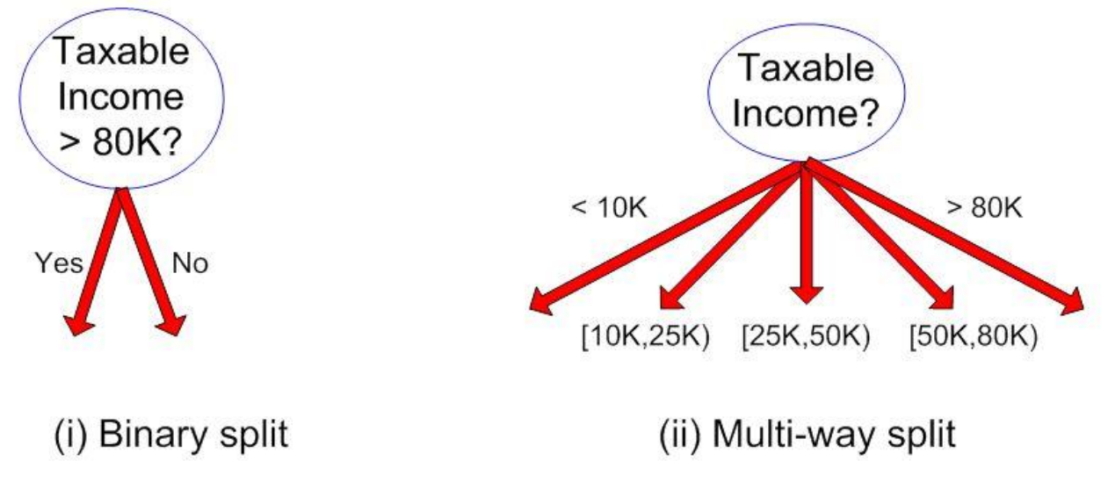
Discretization and Concept hierarchy
Discretization
reduce the number of values for a given continuous attribute by dividing the range of the attribute into intervals. Interval labels can then be used to replace actual data values, e.g. salary, price, age
Concept hierarchies
reduce the data by collecting and replacing low level concepts (such as numeric values for the attribute age) by higher level concepts (such as young, middle-aged, or senior) place-street-city-country

Slide 4
Discretization and Concept Hierarchy Generation for Numeric Data
Binning (see sections before)
Histogram analysis (see sections before)
Clustering analysis (see sections before)
Entropy-based discretization
Segmentation by natural partitioning

Slide 5
Entropy-Based Discretization
samples S, S is partitioned into two intervals S₁ and S₂ using boundary T, the information gain(信息增益) after partitioning is
Calculated based on class distribution of the samples in the set. Given m classes, the entropy of S₁ is
where p_{i} is the probability of class i in S₁
The boundary that minimizes the entropy function over all possible boundaries is selected as a binary discretization
The process is recursively applied to partitions obtained until some stopping criterion is met
Such a boundary may reduce data size and improve classification accuracy

Slide 6
Interval Merge by χ² Analysis
Merging-based (bottom-up) vs. splitting-based methods
Merge: Find the best neighboring intervals and merge them to form larger intervals recursively
ChiMerge
Initially, each distinct value of a numerical attr. A is considered to be one interval
χ² tests are performed for every pair of adjacent intervals
Adjacent intervals with the least χ² values are merged together
This merge process proceeds recursively until a predefined stopping criterion is met (such as significance level, max-interval, max inconsistency, etc.)

Slide 7
Segmentation by Natural Partitioning
A simply 3-4-5 rule can be used to segment numeric data into relatively uniform, “natural” intervals.
If an interval covers 3, 6, 7 or 9 distinct values at the most significant digit(最高有效位), partition the range into 3 equi-width intervals
If it covers 2, 4, or 8 distinct values at the most significant digit, partition the range into 4 intervals
If it covers 1, 5, or 10 distinct values at the most significant digit, partition the range into 5 intervals

Slide 8
Example of 3-4-5 Rule
count
Step 1:
-$351 -$159 profit $1,838 $4,700
Min Low (i.e, 5%-tile) High(i.e, 95%-0 tile) Max
Step 2:
msd=1,000 Low=-$1,000 High=$2,000
Step 3:
(-$1,000 - $2,000)
(-$1,000 - 0)
(0 -$ 1,000)
($1,000 - $2,000)
Step 4:
(-$400 -$5,000)
(-$400 - 0)
(0 - $1,000)
($1,000 - $2, 000)
($2,000 - $5, 000)
(-$400 -
-$300)
(0 -
$200)
($1,000 -
$1,200)
($2,000 -
$3,000)
($200 -
$400)
($1,200 -
$1,400)
(-$300 -
-$200)
($3,000 -
$4,000)
($400 -
$600)
($1,400 -
$1,600)
(-$200 -
-$100)
($4,000 -
$5,000)
($600 -
$800)
($1,600 -
$1,800)
($1,800 -
$2,000)
(-$100 -
0)
($800 -
$1,000)

Slide 9
Concept Hierarchy Generation for Categorical Data
Specification of a partial ordering of attributes explicitly at the schema level by users or experts
street<city<state<country
Specification of a portion of a hierarchy by explicit data grouping
{Urbana, Champaign, Chicago}<Illinois
Specification of a set of attributes.
System automatically generates partial ordering by analysis of the number of distinct values
E.g., street < city <state < country
Specification of only a partial set of attributes
E.g., only street < city, not others

Slide 10
Automatic Concept Hierarchy Generation
Some concept hierarchies can be automatically generated based on the analysis of the number of distinct values per attribute in the given data set
The attribute with the most distinct values is placed at the lowest level of the hierarchy
Note: Exception—weekday, month, quarter, year
country
15 distinct values
province_or_ state
65 distinct values
city
3567 distinct values
street
674,339 distinct values

Slide 11
Summary
Data preparation or preprocessing is a big issue for both data warehousing and data mining
Discriptive data summarization is needed for quality data preprocessing
Data preparation includes
Data cleaning and data integration
Data reduction and feature selection
Discretization
A lot of methods have been developed but data preprocessing still an active area of research

Slide 12
References
D. P. Ballou and G. K. Tayi. Enhancing data quality in data warehouse environments. Communications of ACM, 42:73-78, 1999
T. Dasu and T. Johnson. Exploratory Data Mining and Data Cleaning. John Wiley & Sons, 2003
T. Dasu, T. Johnson, S. Muthukrishnan, V. Shkapenyuk. Mining Database Structure; Or, How to Build a Data Quality Browser. SIGMOD’02.
H.V. Jagadish et al., Special Issue on Data Reduction Techniques. Bulletin of the Technical Committee on Data Engineering, 20(4), December 1997
D. Pyle. Data Preparation for Data Mining. Morgan Kaufmann, 1999
E. Rahm and H. H. Do. Data Cleaning: Problems and Current Approaches. IEEE Bulletin of the Technical Committee on Data Engineering. Vol.23, No.4
V. Raman and J. Hellerstein. Potters Wheel: An Interactive Framework for Data Cleaning and Transformation, VLDB’2001
T. Redman. Data Quality: Management and Technology. Bantam Books, 1992
Y. Wand and R. Wang. Anchoring data quality dimensions ontological foundations. Communications of ACM, 39:86-95, 1996
R. Wang, V. Storey, and C. Firth. A framework for analysis of data quality research. IEEE Trans. Knowledge and Data Engineering, 7:623-640, 1995

Slide 13
Thanks！
Notes:
工作新意图发现

